Slide 1


Team 18: Kubernetes
Based Attacks
Bi-Weekly Update 3 Thomas Gumienny, Patrick Churchill, Albert Ma Sponsor: Sandip Roy TA: Sabyasachi Gupta
Notes:
Michelle

Slide 2
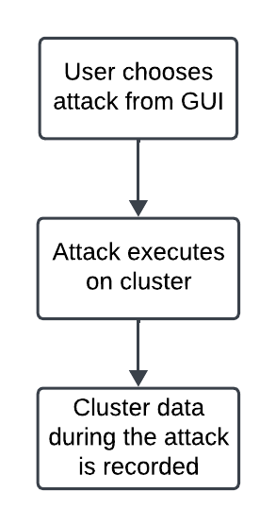
Project Summary
The US Navy is using Kubernetes to manage software. However, as a relatively new cyberservice, Kubernetes has a variety of cybersecurity weaknesses.
Develop a Kubernetes testbed that can simulate and collect the data of common types of attacks.
Notes:
Kyle

Slide 3
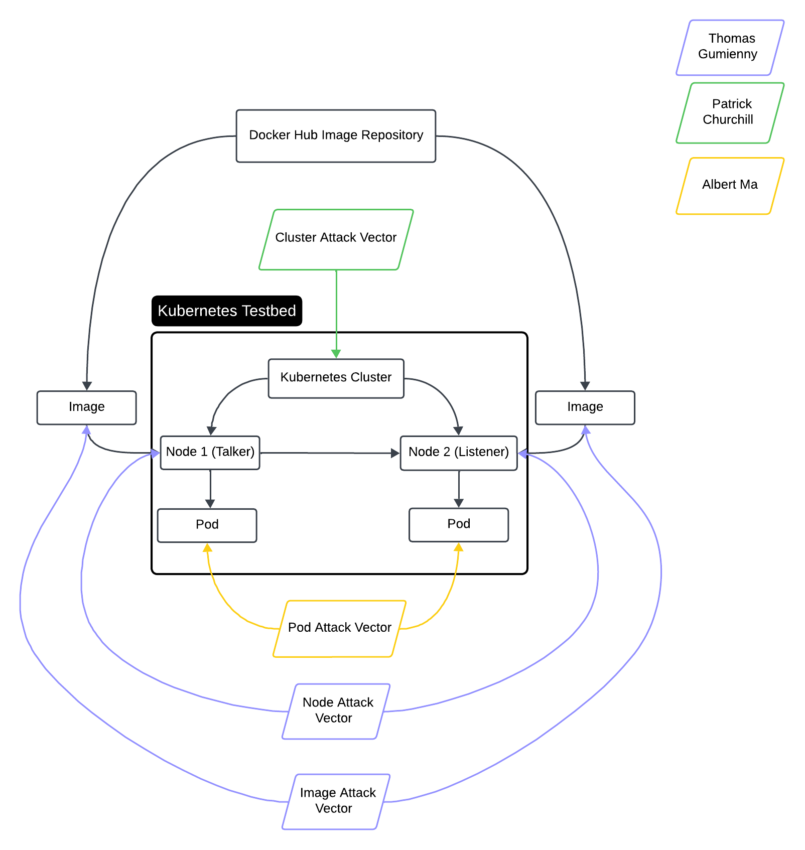
Project/Subsystem Overview
Thomas Gumienny - Image Attack
Image has similar name to normal docker image
When run, image consumes CPU/GPU resources
Albert Ma - Pod Attack
Set up target pod, and conduct reconnaissance on network
Gain access to target pod and container and all stored info
Patrick Churchill - Cluster Attack
Server Node applies pods upon Agent Node that overload the memory and CPU on Server Node, causing it to crash
Notes:
Eric

Slide 4
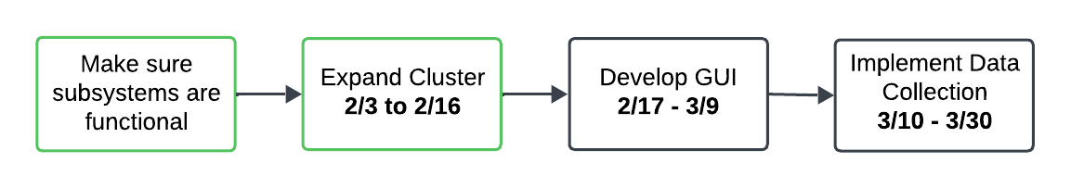
Project Timeline
Notes:
Eric

Slide 5
Image Attack Vector
Thomas Gumienny
Accomplishments since 2/5 16 hrs of effort | Ongoing progress/problems and plans until the next presentation
Camera image has been converted to a kubernetes deployment Barebones command-line GUI created Image attack has been run using GUI command line | Make attack executable python function Use Lens and Kubeshark to gather attack data

Slide 6
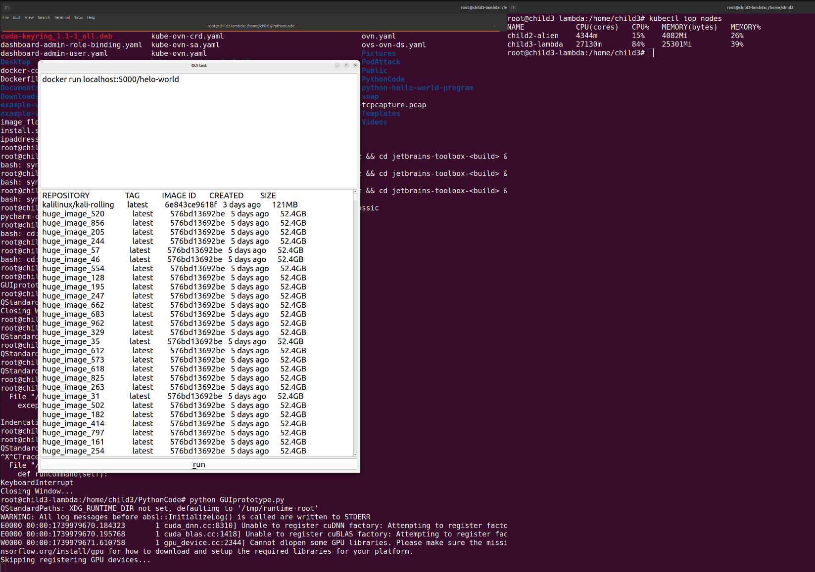
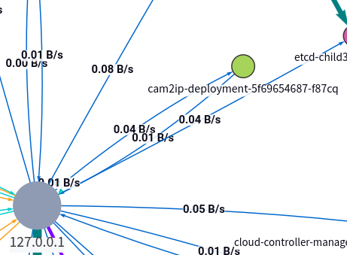
Image Attack Vector
Thomas Gumienny

Slide 7
Node Attack Vector
Patrick Churchill
Accomplishments since 2/5 14 hrs of effort | Ongoing progress/problems and plans until the next presentation
Installed Online Lens to further measure impact of attacks on cluster Node attack has been run using GUI command line | Further developing GUI to include attack buttons Cleaning up GUI interface to be more presentable

Slide 8
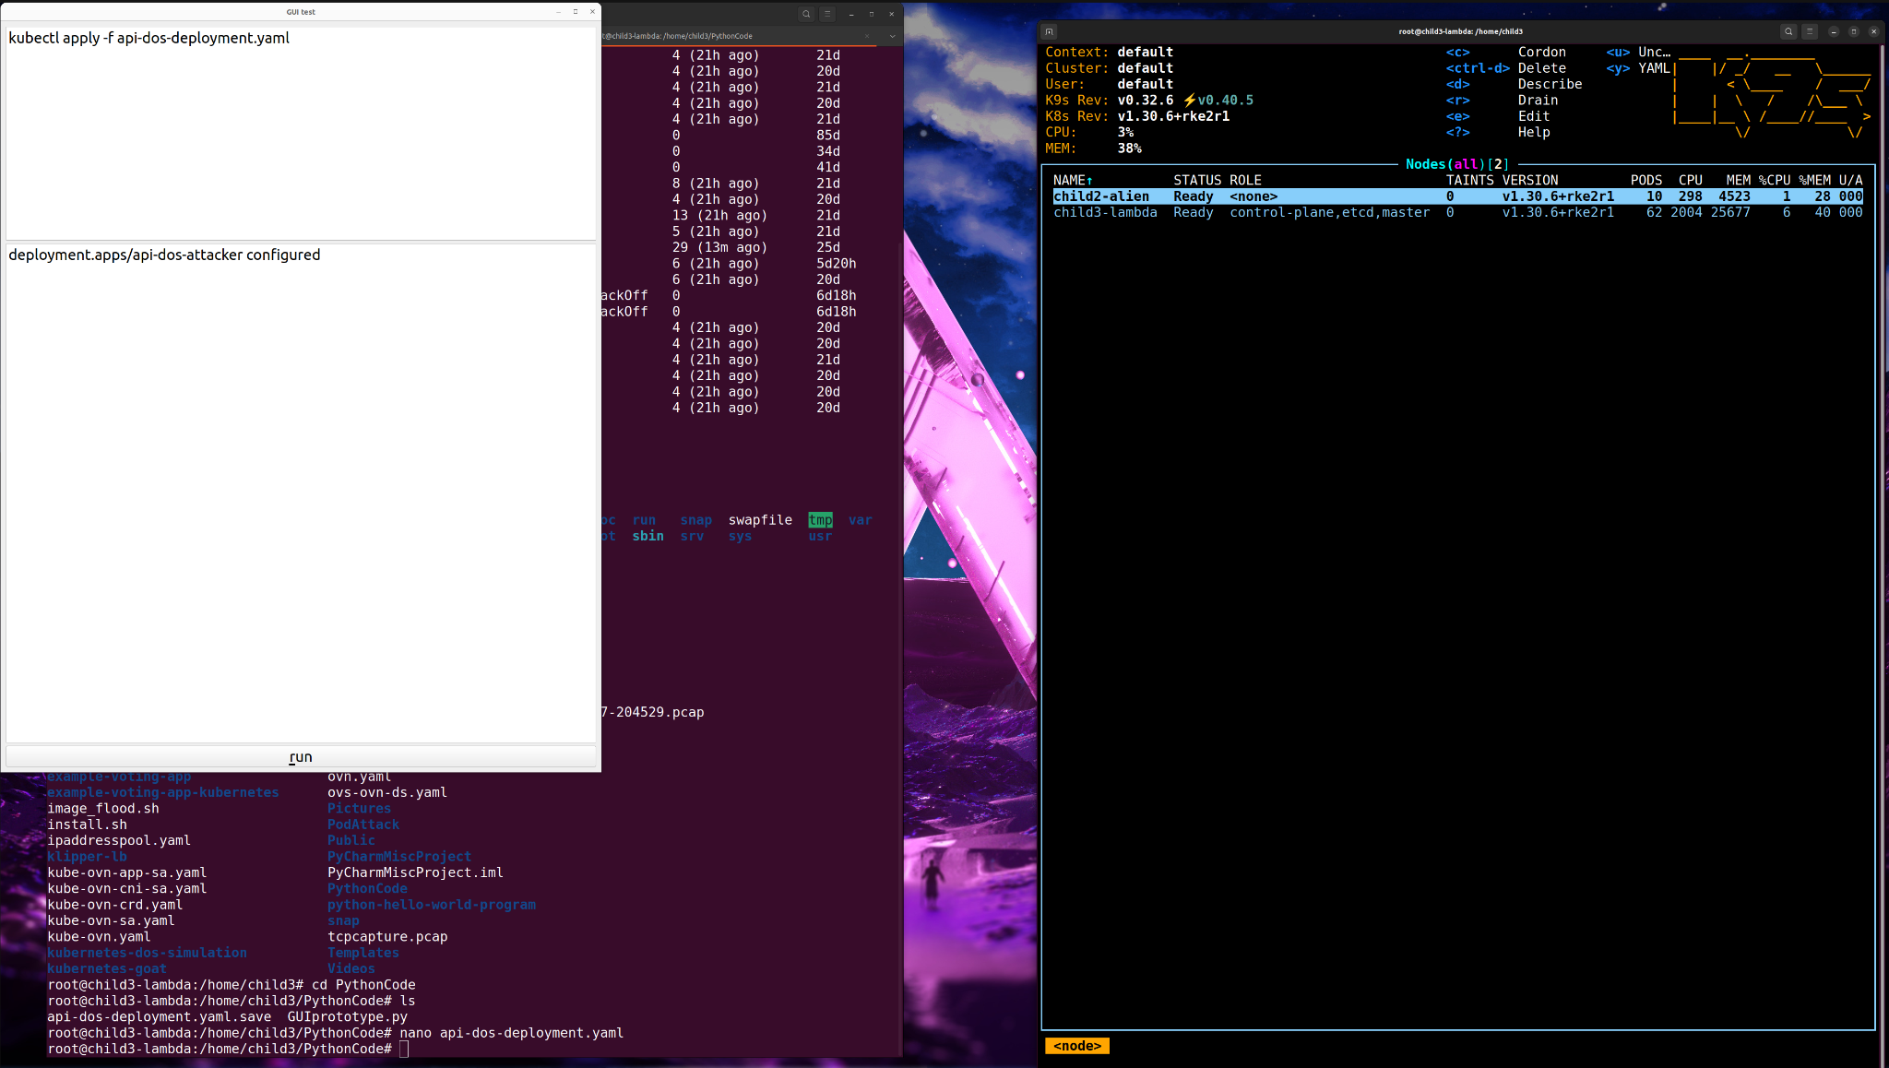
Node Attack Vector
Patrick Churchill

Slide 9
Pod Attack Vector
Albert Ma
Accomplishments since 2/5 15 hrs of effort | Ongoing progress/problems and plans until the next presentation
Developed a Python script that extracts the information stored in env variables Developed a python script that can execute a command based on changes made to the env variable csv file (i.e. the PATH and Kubeconfig) Developed a bash script that spam creates semi-large images (and apparently crashes the pod/computer) | Running attack in GUI Test, Verification, and data analysis of the attack scripts Unify the two Python scripts to one that can change an env variable set by the user (declutter the scripts)

Slide 10
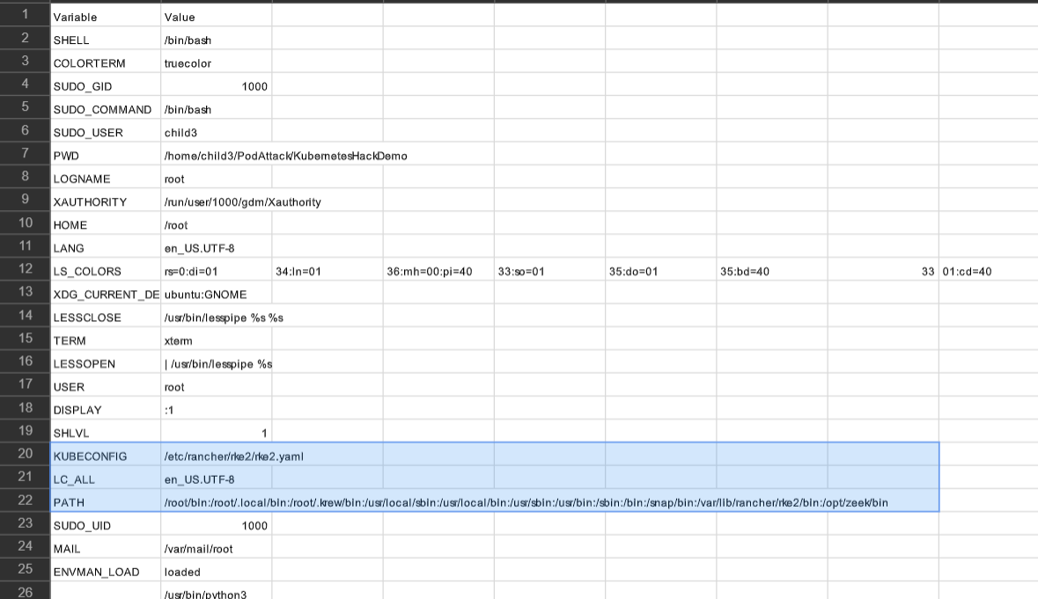
Pod Attack Vector
Albert Ma

Slide 11
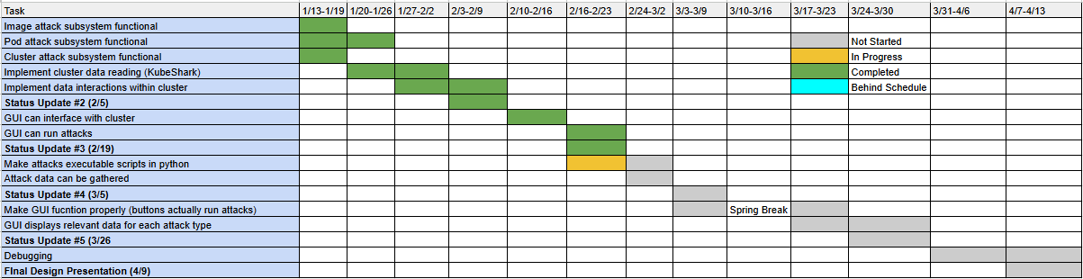
Execution Plan
Notes:
Michelle

Slide 12
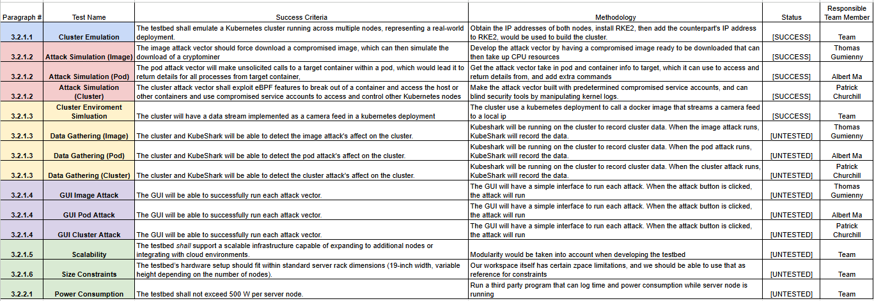
Validation Pan
Notes:
Michelle

Slide 13
Thank You

